Slide 1
Session 22
Logistic Regression
From Classification Problems to Spam Detection
■ Classification Problems
■ Sigmoid Function & Decision Boundaries
■ Model Training & Evaluation
■ Hands-on: Spam Detector
AI / ML Foundations | College Course

Slide 2
Topic 1 · Classification Problems
What is a Classification Problem?
In regression, we predict a number. In classification, we predict a category.
📌 Classification predicts which group/class an item belongs to — not a number.
🩺 Medical
📧 Email
🌤 Weather
Is this tumour Malignant or Benign?
Is this email Spam or Not Spam?
Will it rain tomorrow?
→ Yes / No
→ Spam / Ham
→ Yes / No

Slide 3
Topic 1 · Classification Problems
Why Not Just Use Linear Regression?
Linear regression can predict values like 2.7 or -1.5. But probability must stay between 0 and 1. Linear regression breaks this rule.
Linear Regression
Logistic Regression
Output: any real number (-∞ to +∞)
Output: probability (0 to 1)
Best for: house prices, salaries
Best for: spam, disease, fraud
Can predict nonsense like 1.8 or -0.3 for a probability!
Always outputs valid probability
Uses straight line
Uses S-shaped sigmoid curve
💡 Logistic Regression is NOT actually a regression — it's a classification algorithm!

Slide 4
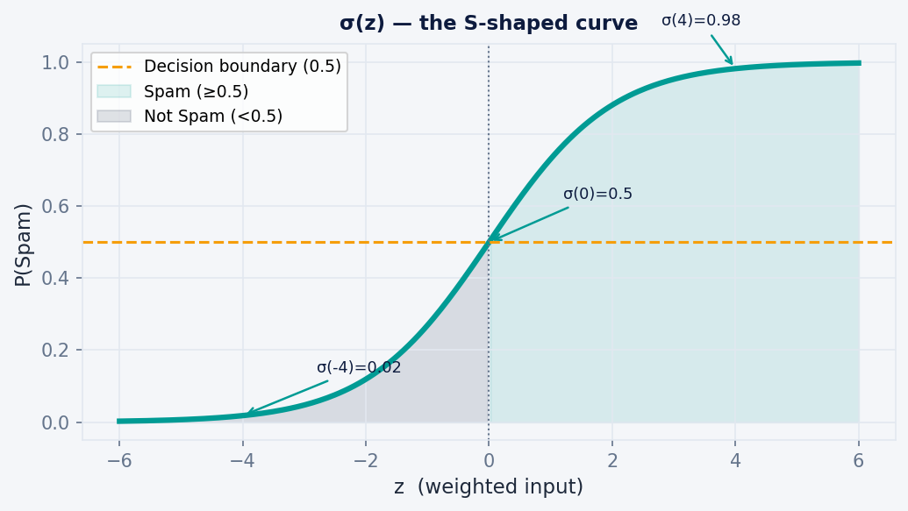
Topic 2 · Sigmoid Function
The Sigmoid Function — The Heart of Logistic Regression
σ(z) = 1 / (1 + e⁻ᶻ) where z = w₁x₁ + w₂x₂ + … + b
Output Range
0 to 1 → valid probability
At z = 0
σ(0) = 0.5 → 50/50
At z very +
σ(z) → 1 → almost certain Spam
At z very −
σ(z) → 0 → almost certain Not Spam

Slide 5
Topic 2 · Sigmoid Function
Worked Example: Is This Email Spam?
An email has: 20 spam words, 10 exclamation marks, 5 links. The model has learned weights: w₁=0.3, w₂=0.5, w₃=0.2, bias b = −8
Step 1
Compute z (weighted sum)
z = 0.3×20 + 0.5×10 + 0.2×5 + (−8) = 6 + 5 + 1 − 8 = 4
Step 2
Apply sigmoid
σ(4) = 1 / (1 + e⁻⁴) = 1 / (1 + 0.018) ≈ 0.982
Step 3
Apply decision threshold
0.982 ≥ 0.5 → Predict SPAM ✓

Slide 6
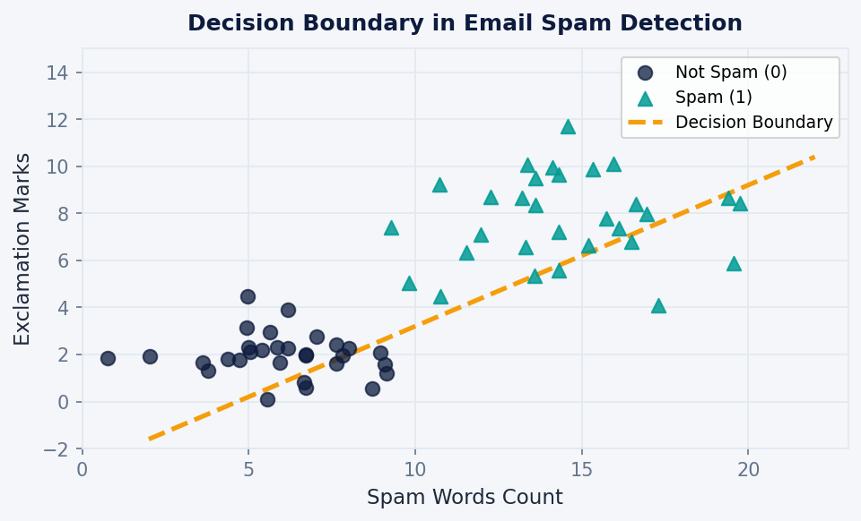
Topic 3 · Decision Boundaries
Decision Boundary — The Dividing Line
The decision boundary is the line (or curve) that separates the two classes. Where the model says "I'm 50/50" — that's the boundary.
Above boundary
Model predicts Spam (P ≥ 0.5)
Below boundary
Model predicts Not Spam (P < 0.5)
On the boundary
P = 0.5 → uncertain!
Threshold
Default is 0.5; can be changed

Slide 7
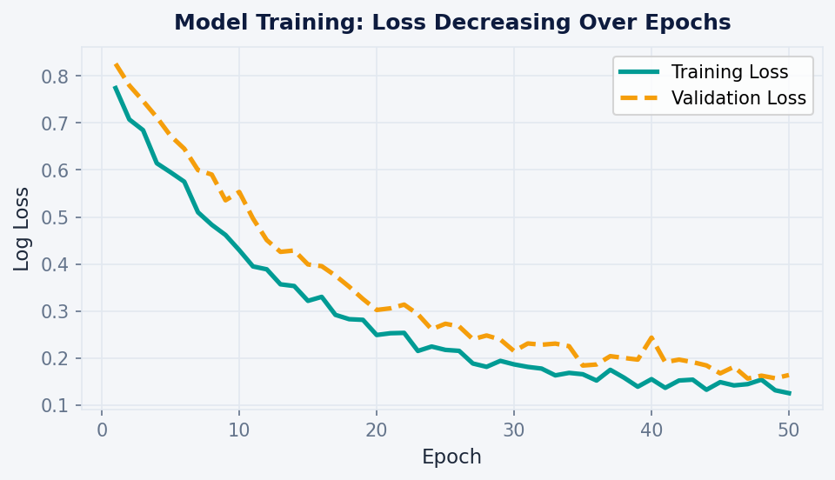
Topic 4 · Model Training
How Does the Model Learn? (Training)
1
2
3
4
5
Start with random weights (w₁, w₂, …, b)
For each email: Compute ẑ → sigmoid → P(Spam)
Calculate Log Loss: How wrong was the prediction?
Adjust weights (Gradient Descent) to reduce the loss
Repeat for all emails (one epoch). Do many epochs.
→
→
→
→
Log Loss = −[y · log(p) + (1−y) · log(1−p)] ← what the model minimizes
Loss goes down as model learns:

Slide 8
Topic 4 · Model Training
Log Loss — How We Measure Error
Log Loss penalises the model MORE when it is very CONFIDENT and WRONG.
Actual
Predicted P(Spam)
Loss
Meaning
Spam (y=1)
P = 0.99
Very Low ✓
Correct + confident → good!
Spam (y=1)
P = 0.60
Moderate
Correct but unsure
Spam (y=1)
P = 0.10
Very High ✗
Wrong + confident → BIG penalty
Not Spam (y=0)
P = 0.01
Very Low ✓
Correct + confident → good!
Not Spam (y=0)
P = 0.90
Very High ✗
Wrong + confident → BIG penalty
💡 Gradient Descent nudges the weights step-by-step to minimise this total loss across all training emails.

Slide 9
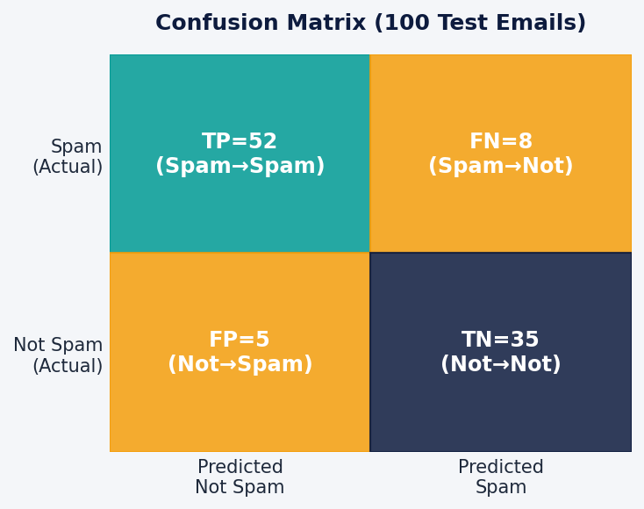
Topic 5 · Model Evaluation
Evaluating the Model — Confusion Matrix
After training, we test on 100 unseen emails and build a Confusion Matrix:
Accuracy
(52+35)/100 = 87%
Overall correct predictions
Precision
52/(52+5) = 91.2%
Of all spam calls, how many really were?
Recall
52/(52+8) = 86.7%
Of all actual spam, how many did we catch?
F1 Score
≈ 88.8%
Balance between Precision & Recall

Slide 10
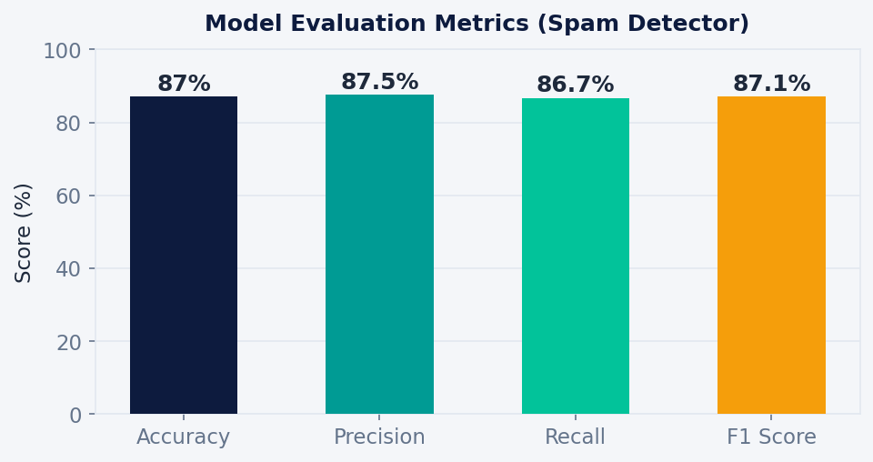
Topic 5 · Model Evaluation
Precision vs Recall — The Trade-off
When to prefer Recall?
Medical diagnosis — missing a sick patient is WORSE than a false alarm. → Maximise Recall
When to prefer Precision?
Spam filter — flagging real emails as spam is annoying & costly. → Maximise Precision
💡 F1 Score = Harmonic Mean of Precision & Recall → use when both matter equally

Slide 11
🔬 Hands-On · Spam Detector (Python)
Building a Spam Classifier with Logistic Regression
from sklearn.linear_model import LogisticRegression from sklearn.model_selection import train_test_split from sklearn.metrics import classification_report # Features: [spam_words, exclamations, links] X = [[20,10,5],[2,1,0],[18,8,3],[1,0,1], [15,6,4],[3,2,0],[22,12,6],[0,0,0]] y = [1,0,1,0,1,0,1,0] # 1=Spam, 0=Not Spam X_train,X_test,y_train,y_test = train_test_split( X, y, test_size=0.2, random_state=42) model = LogisticRegression() model.fit(X_train, y_train) # TRAIN y_pred = model.predict(X_test) # PREDICT print(classification_report(y_test, y_pred))
Sample Output:
precision recall Not Spam 0.91 0.87 Spam 0.85 0.89 Accuracy: 0.87
fit()
Trains the model on labelled data
predict()
Predicts class for new emails
predict_proba()
Returns probabilities (0–1)
classification_report()
Prints all 4 metrics at once

Slide 12
Summary · Session 22
Session 22 — Key Takeaways
Classification
Sigmoid
Decision Boundary
Log Loss
Metrics
Predicts categories (Spam/Not Spam) not continuous numbers
Squashes any number to 0–1 giving a valid probability
The dividing line between classes default threshold = 0.5
Measures how wrong the model is; Gradient Descent minimises it
Accuracy, Precision, Recall, F1 — each answers a different question
"Logistic Regression is the first step into the world of classification. Master it, and every other classifier becomes easier to understand."
📅 Next Session (23): Decision Trees — another powerful classification algorithm that works without probabilities!

